Slide 1

Banking System
Yadnesh Chaudhari
Guide: Mr. Sandip
https://github.com/Yadnesh4/AmdocsJavaProject

Slide 2
Problem statement
At create a bank project, where you can store the customer details.
Give the option to
1) deposite money
2) withdraw money
3) check the balance
and display the final balance.
display the list of customers of the bank with the final balance.
use case and switch,collection to store the customer details and transaction details.
* minimum balance should Rs1000

Slide 3
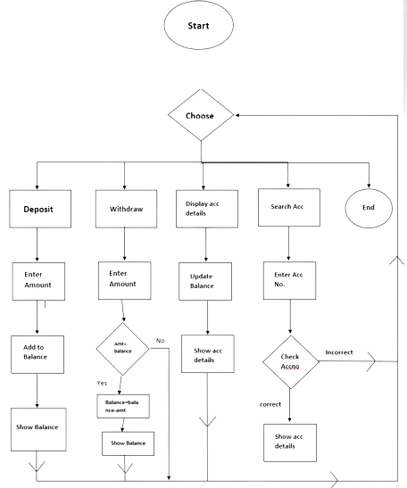
Flowchart

Slide 4
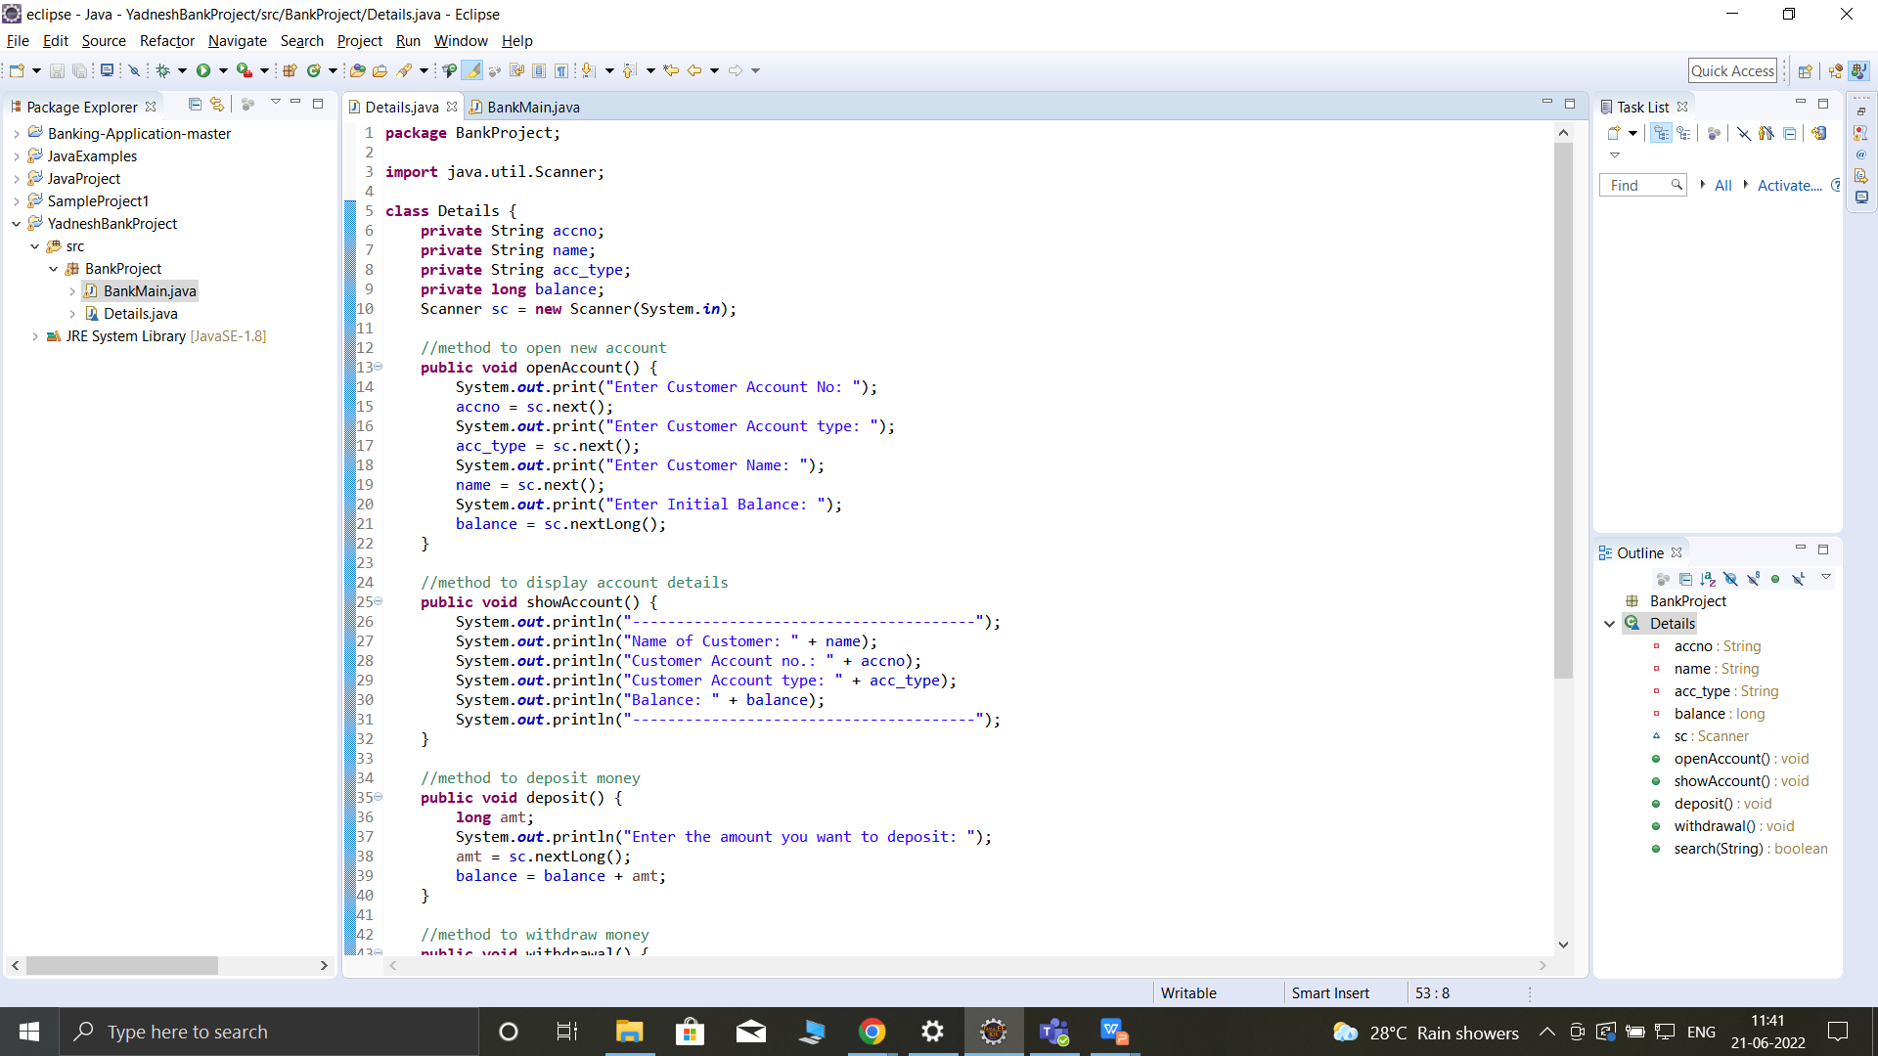
Code

Slide 5
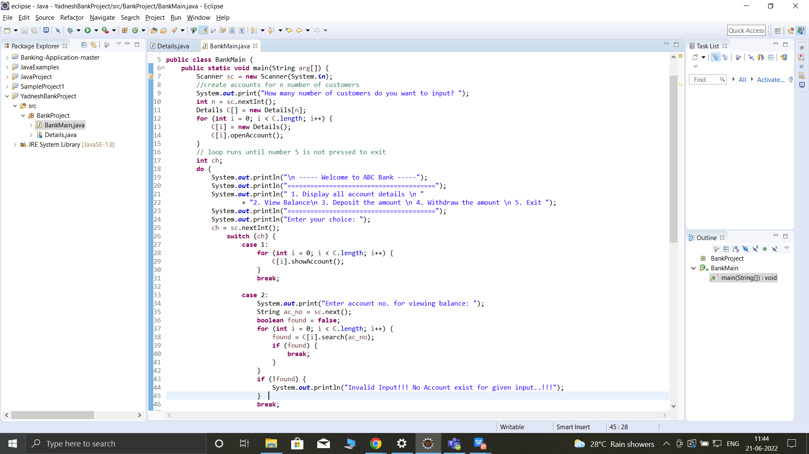
Code

Slide 6
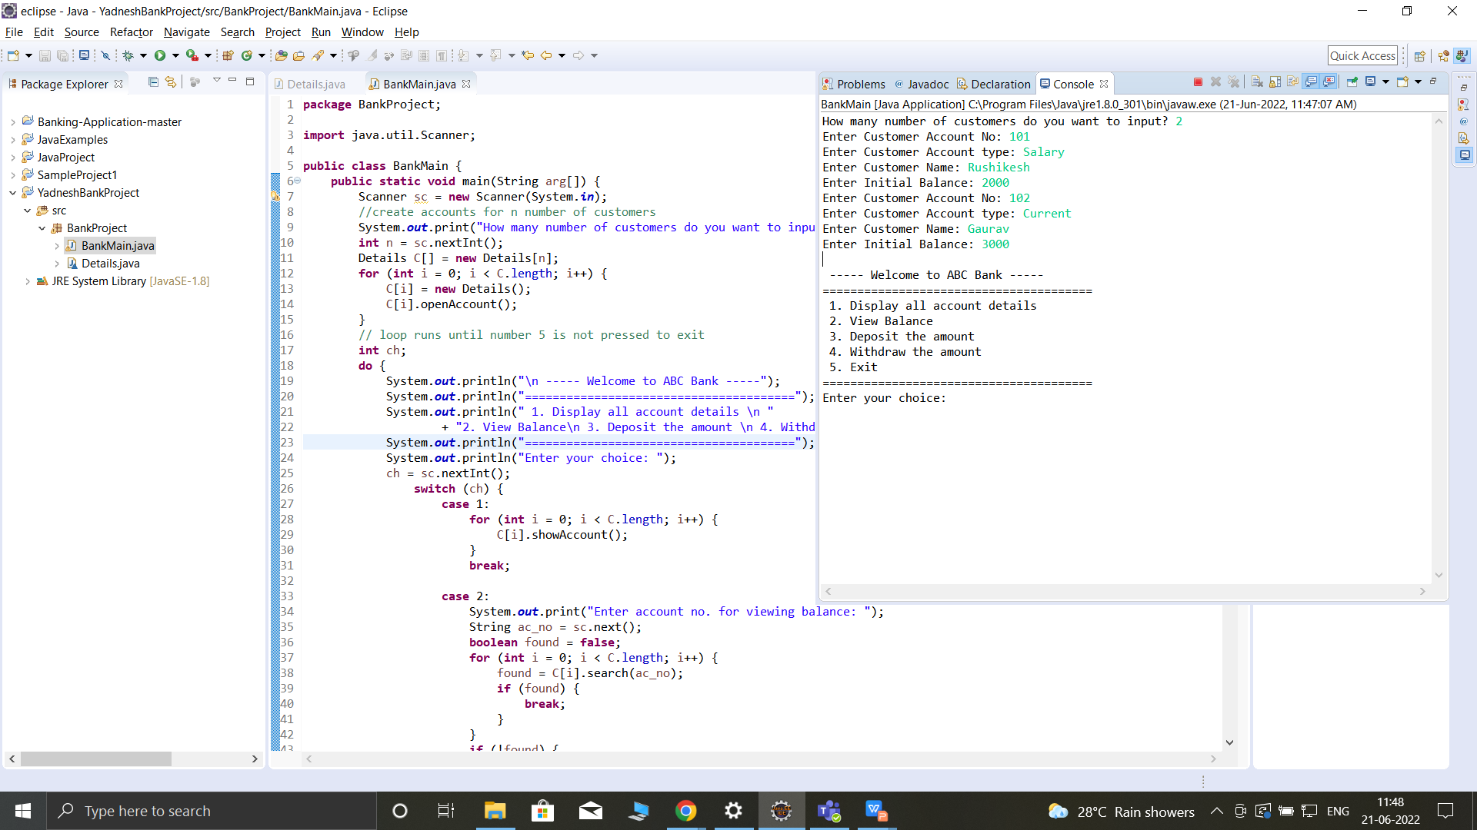
Output
Start Menu
Enter Customer Details

Slide 7
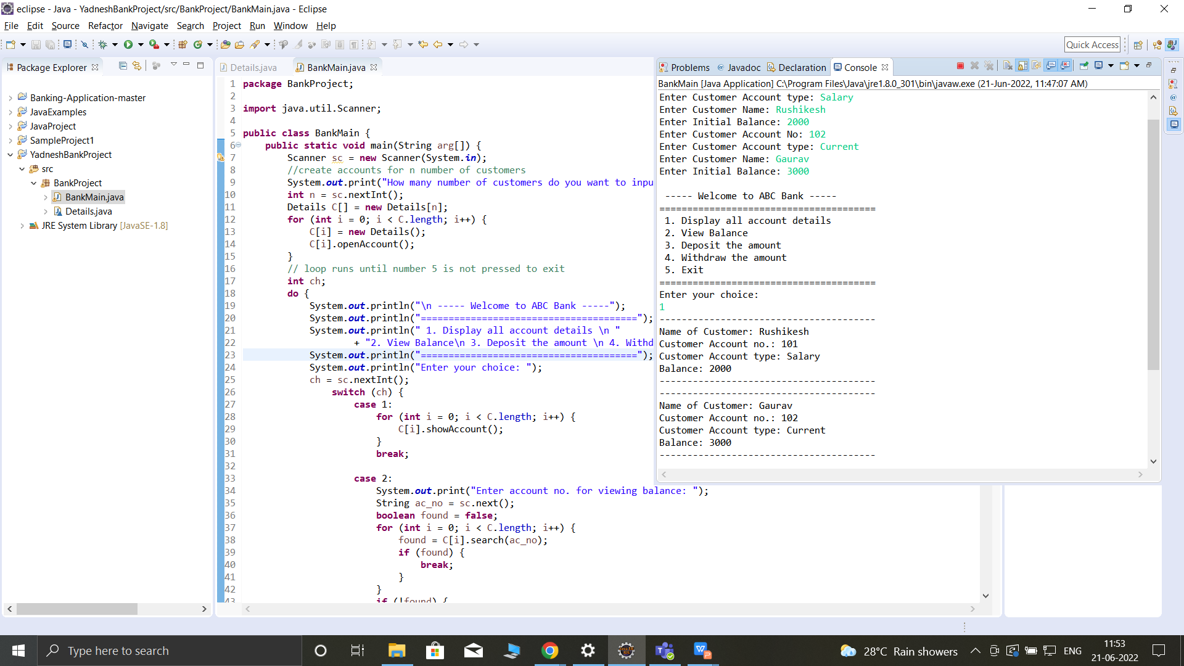
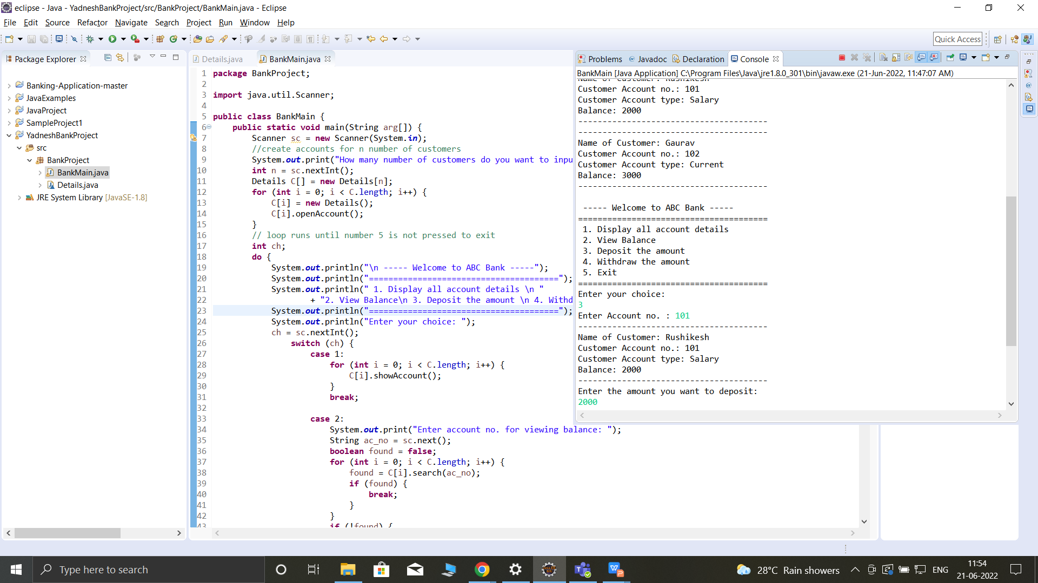
Output
Display all details
Deposit Amount

Slide 8

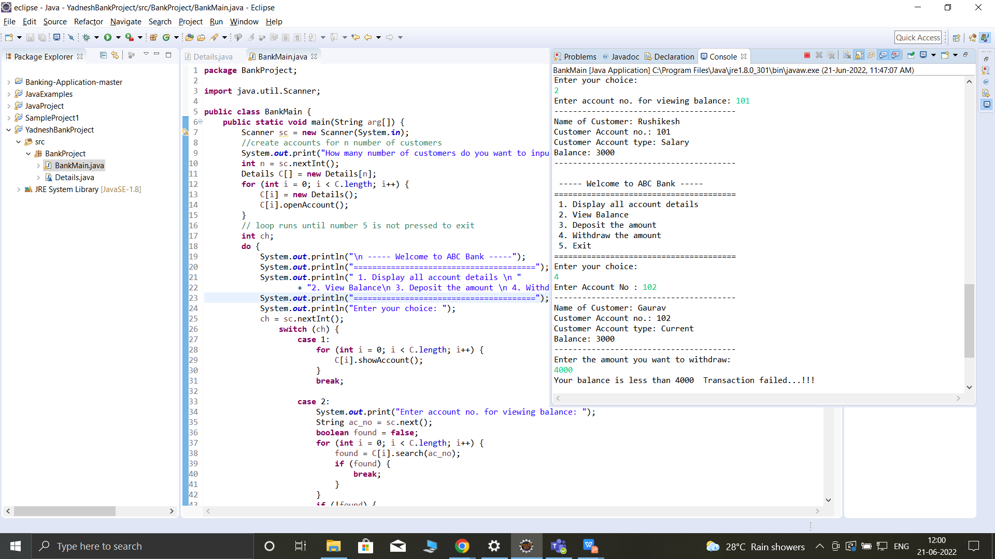
Output
Withdraw Amount
Withdraw Limit

Slide 9

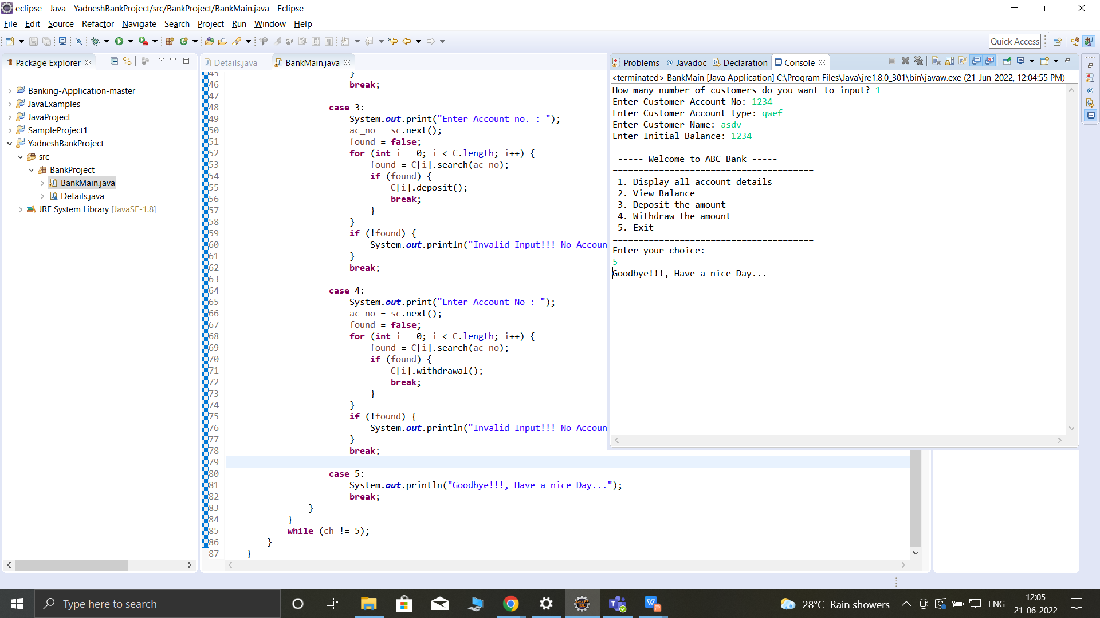
Output
Exit System
View Balance

Slide 10
Thank you
Yadnesh Chaudhari
9923317917
yadneshc@amdocs.com

